Slide 1
Congratulations

Slide 2


Slide 3
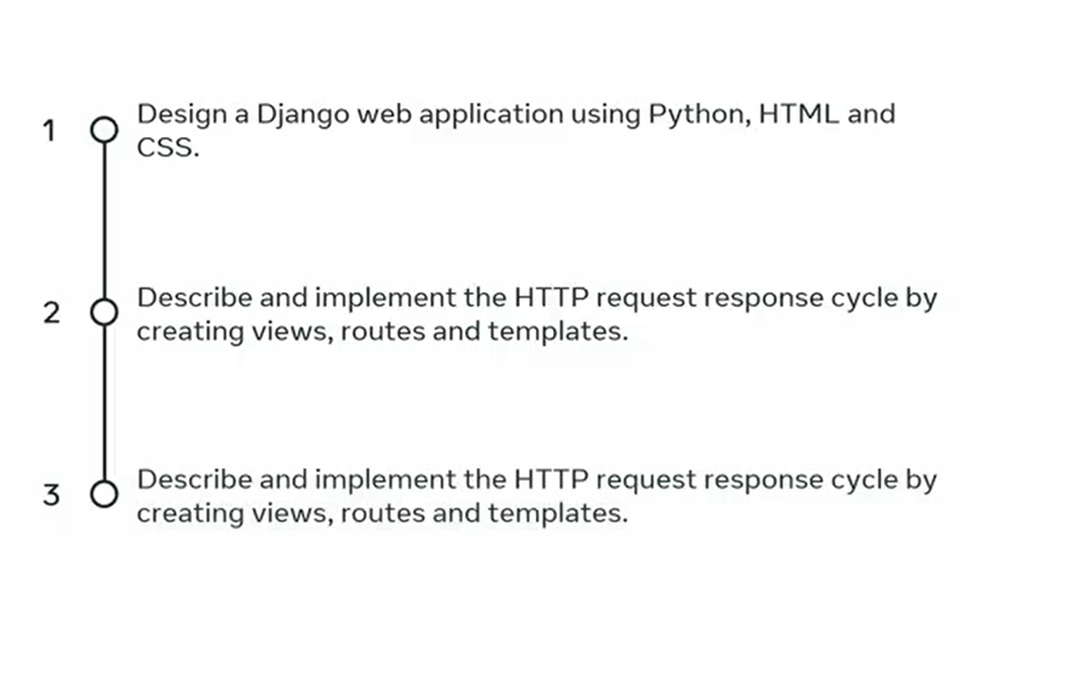

Slide 4
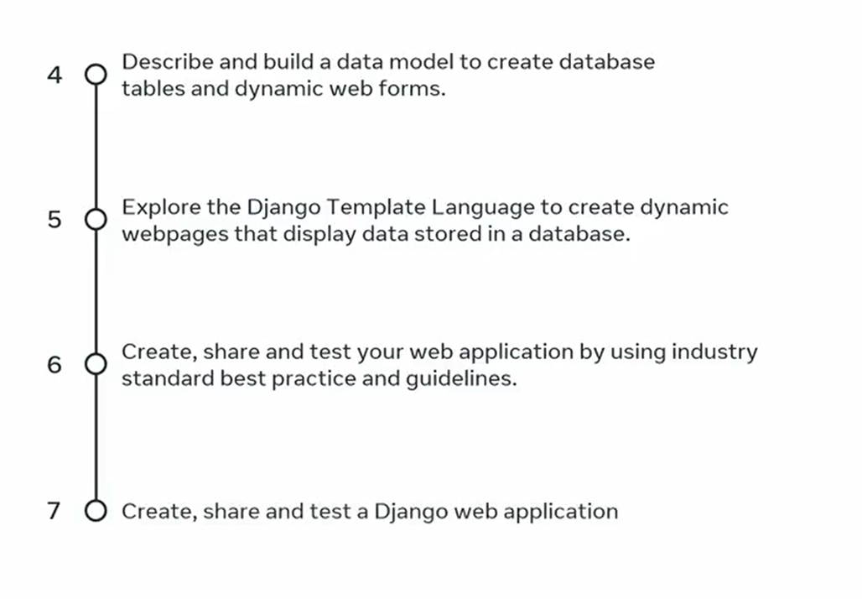

Slide 5


